Slide 1
Section 11.1 Sequences
Lecture 2
Sequence Convergence and Divergence

Slide 2
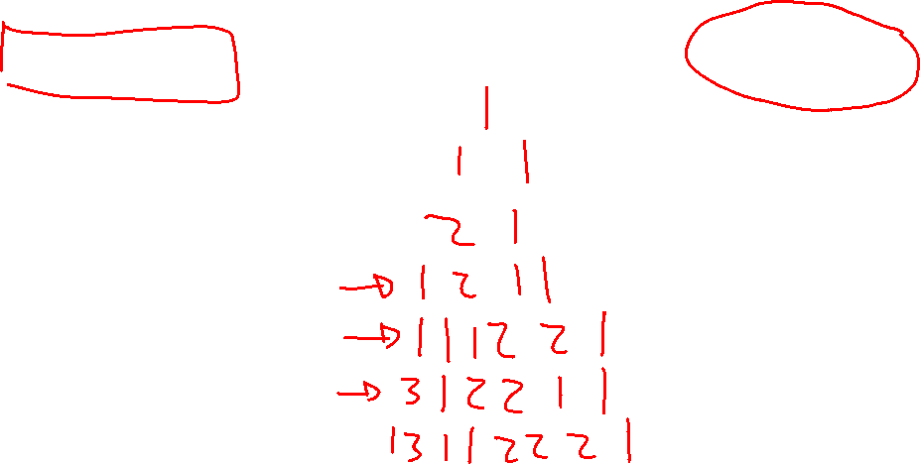
Conway's Famous Sequence: Look-Say
Numberphile video with Conway: LINK

Slide 3
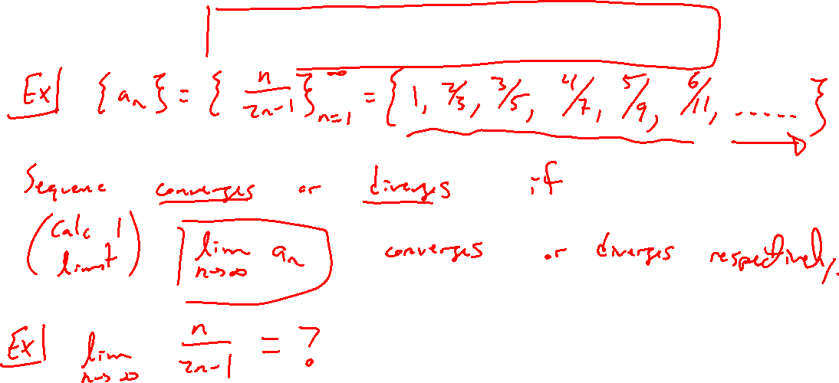
Sequence Convergence / Divergence
Notes:
Example: a_n = n/(2n+1)
Given a_n, question is of end behavior. This is really a limit.
If finite number, converges. If not, divergent (includes infinite limits).
Should remind of limits at infinitey in caluculus 1

Slide 4
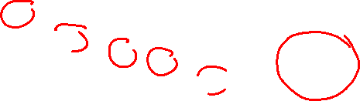
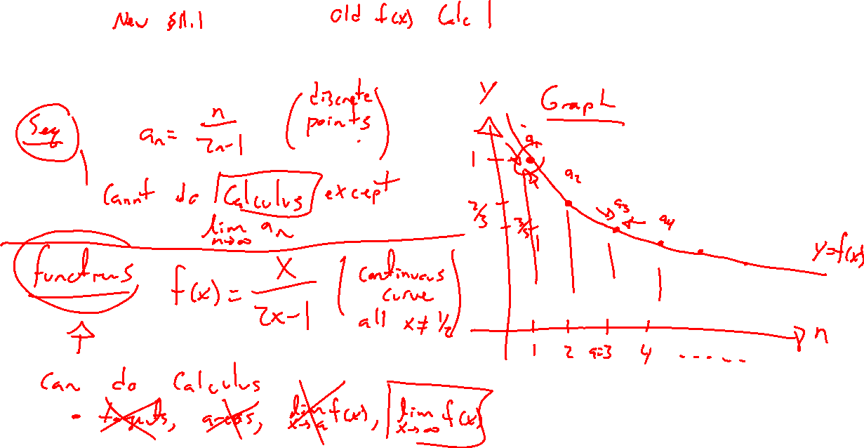
Sequences vs Functions
Notes:
Sequences are discrete, domain only the integers. No finite limits, not diff, not integrable.
Only same as functions in the limit.

Slide 5
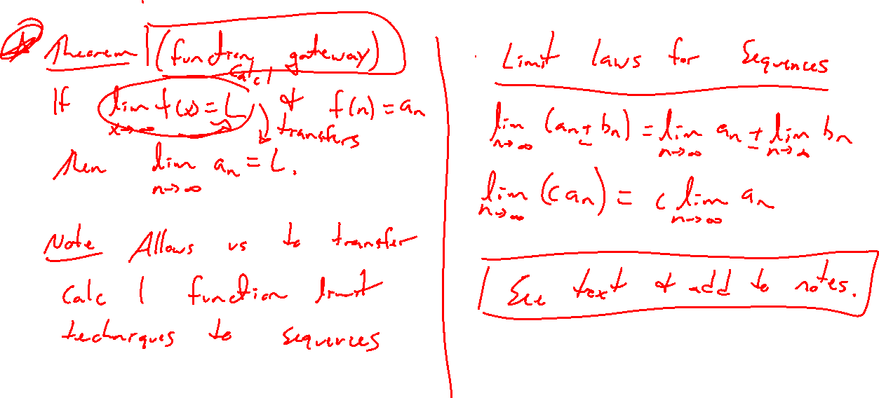
Basic Theorems for Sequence Convergence
Notes:
Function gateway theorem. Limit laws same as calc 1.

Slide 6
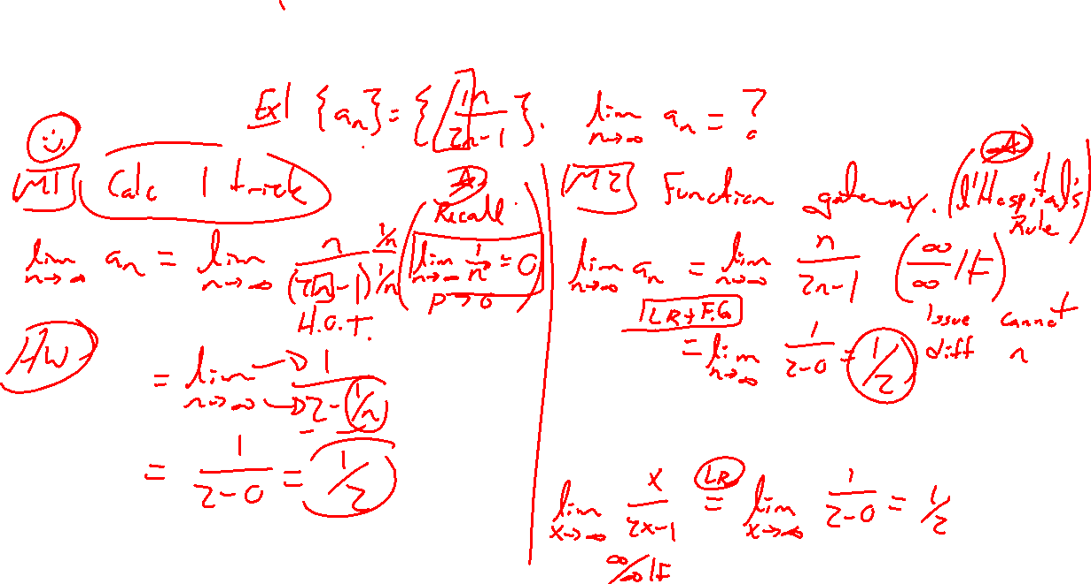
Example: Showing a Sequence Converges
Notes:
a_n = n^2/(3n^2-1) two ways. Divide by HOT. L'hospital's rule

Slide 7
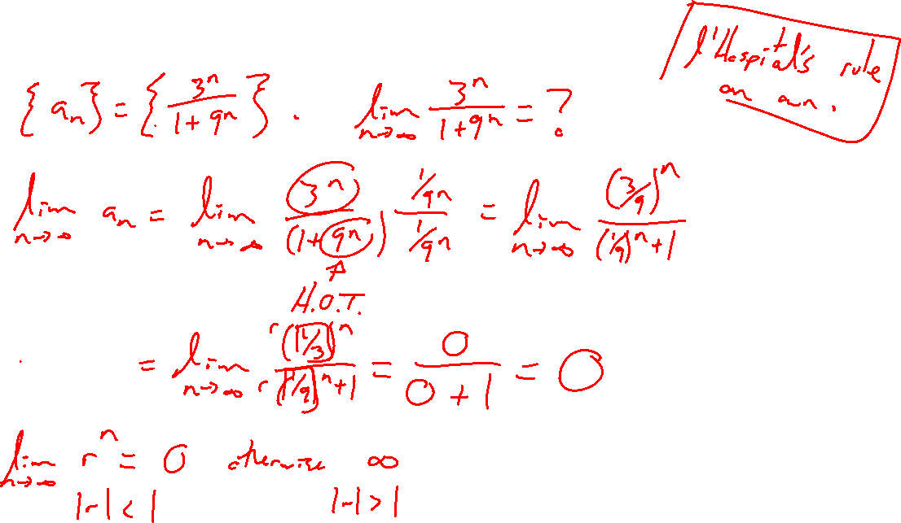
Example: Try on Own
Notes:
a_n = 4^n/(1+9^n)

Slide 8
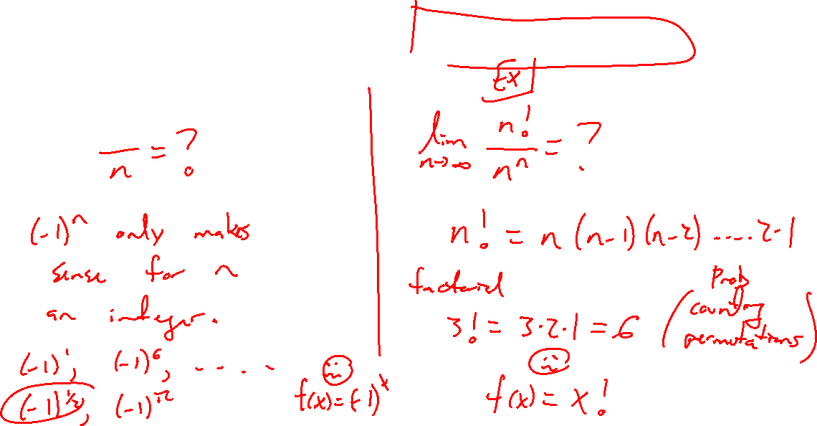
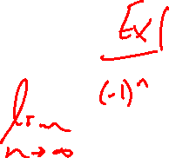
Sequence Convergence: New Situations
Notes:
a_n = (-1)^n/n
a_n = n!/n^n, remind of factorial
Only defined for integer n's

Slide 9
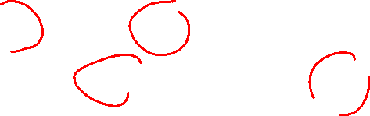
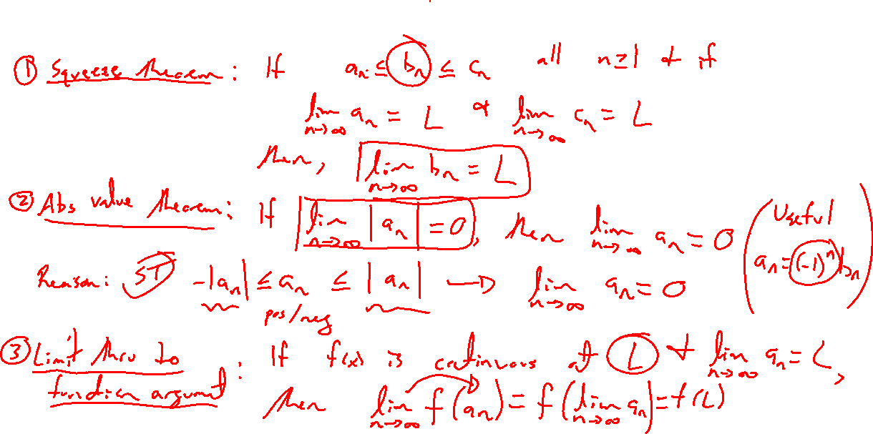
More Theorems for Sequence Convergence
Notes:
Squeeze theorem.
Absolute value theorem.
Pass limit thru continuous function.

Slide 10
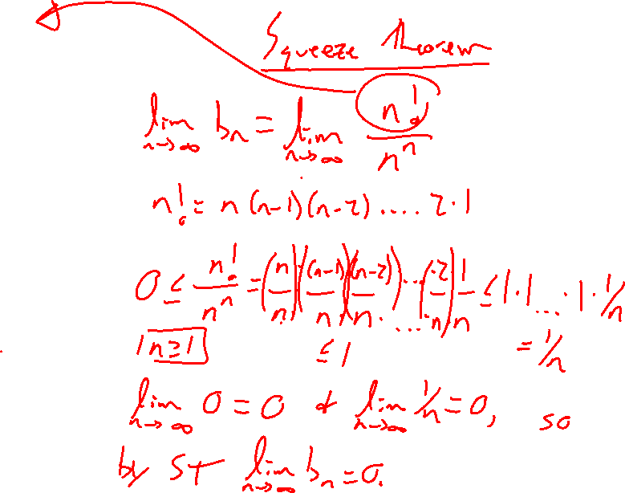
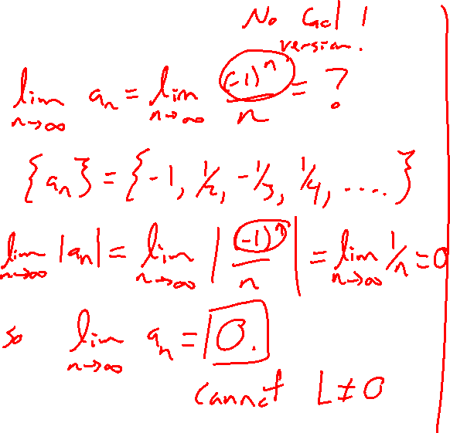
Examples:
Notes:
a_n = (-1)^n/n
a_n = n!/n^n, remind of factorial
Only defined for integer n's

